Slide 1



Raspberry Pi with Java
Intro to Raspberry Pi and Java ME 8
Raspberry Pi Tricks
#RPiJava8
#DevNexus
James Weaver @JavaFXpert
Stephen Chin @SteveOnJava
Java/IoT/Cloud Technology Ambassadors
Oracle Corporation
Copyright © 2014, Oracle and/or its affiliates. All rights reserved. |

Slide 2

Based loosely on upcoming “Raspberry Pi with Java” book by @SteveOnJava and @JavaFXpert
#RPiJava
#DevNexus

Slide 3
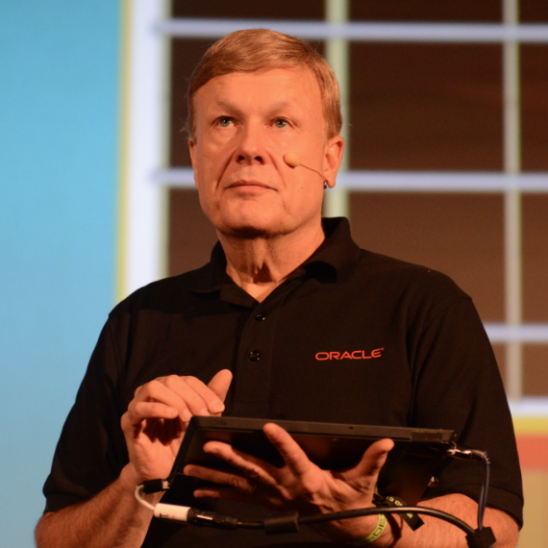
About the first presenter
#RPiJava
#DevNexus
James Weaver
Java/IoT/Cloud Technology Ambassador
Oracle Corporation
Twitter: @JavaFXpert
Email: james.weaver@oracle.com

Slide 4
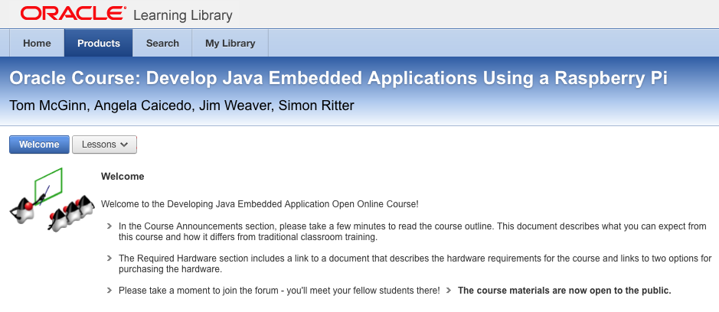
Presentation based upon freely available MOOC

Slide 5

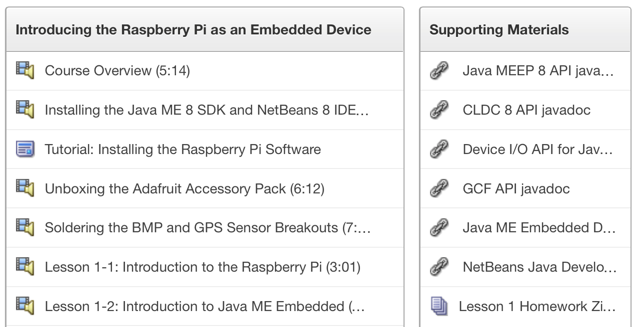
MOOC has videos, code, and other resources

Slide 6
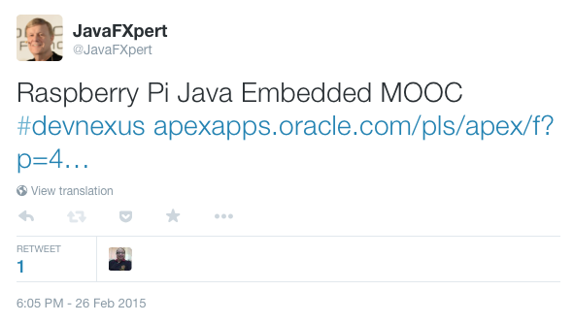
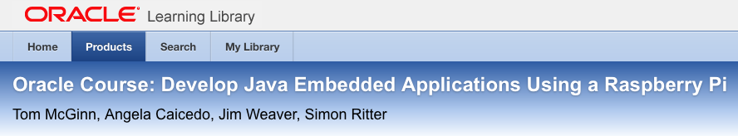
Tweet contains Java Embedded Rasp Pi MOOC

Slide 7
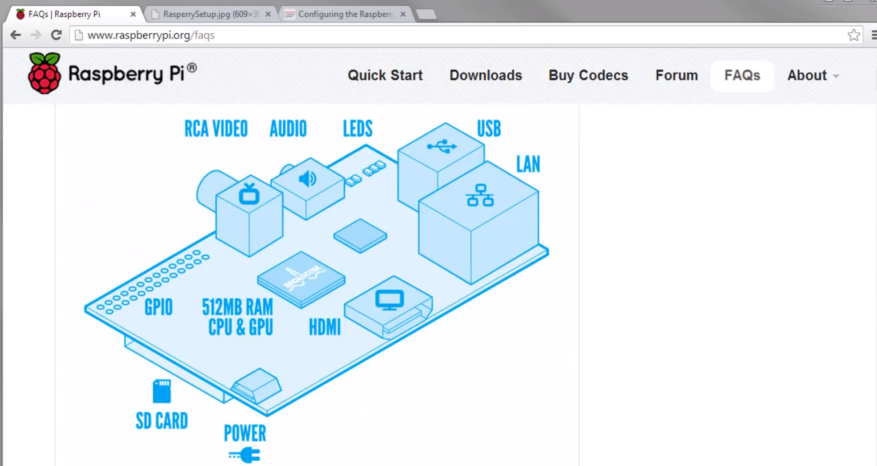
Raspberry Pi Hardware Components

Slide 8
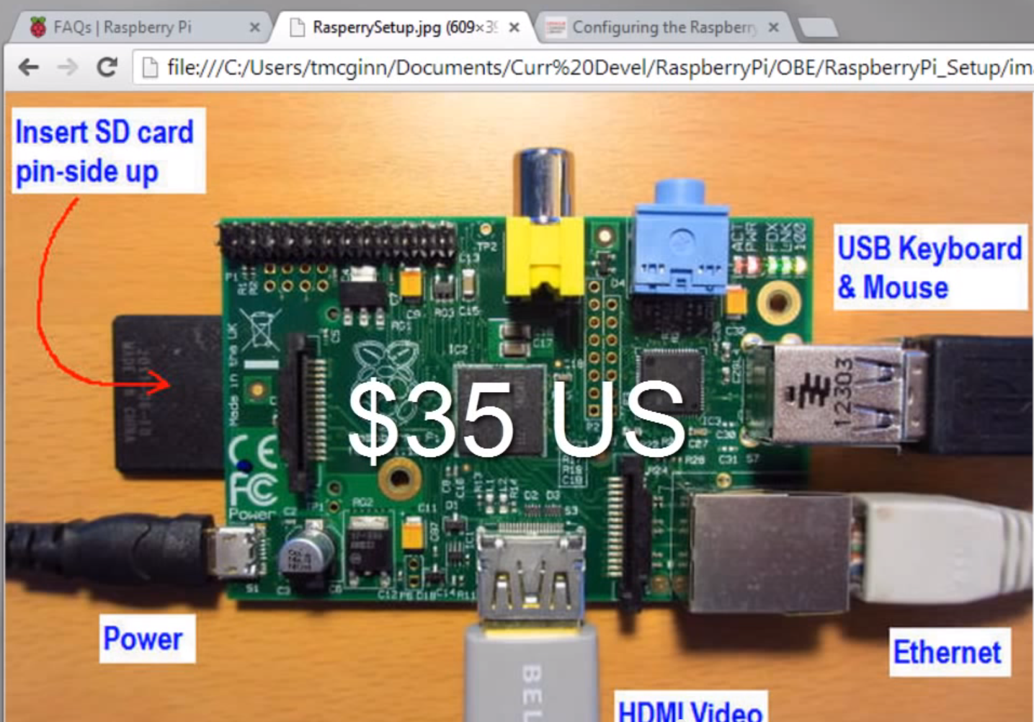
Raspberry Pi Hardware Setup

Slide 9
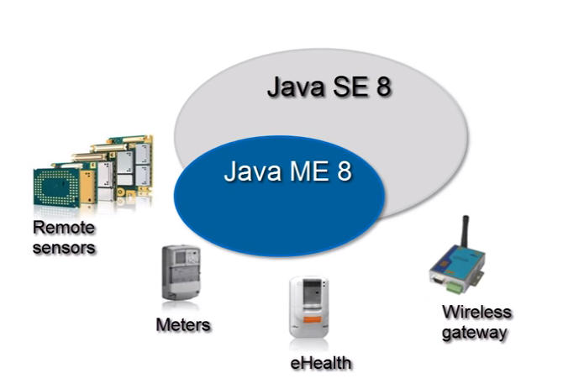
Java SE vs. Java ME

Slide 10
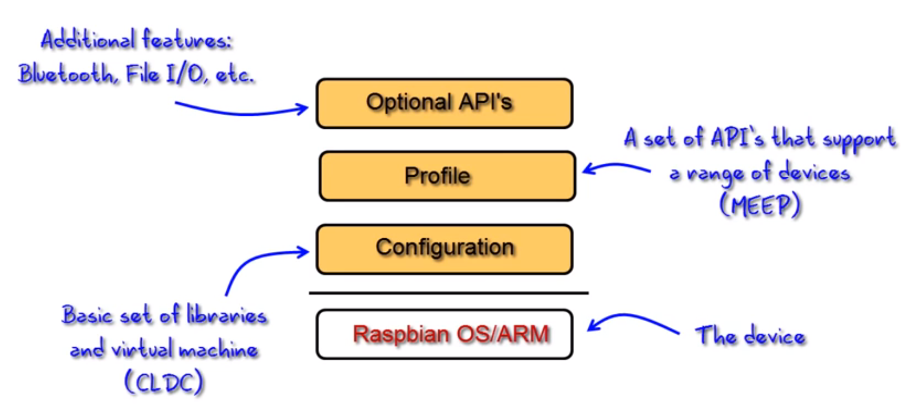
Java ME 8 Architecture

Slide 11
Oracle MOOC: Software Installation Instructions On Your Windows PC
Install Java SE JDK 8
1
Install Java ME SDK 8
2
Install NetBeans 8 IDE
3
Install NetBeans ME SDK Plugins
4

Slide 12
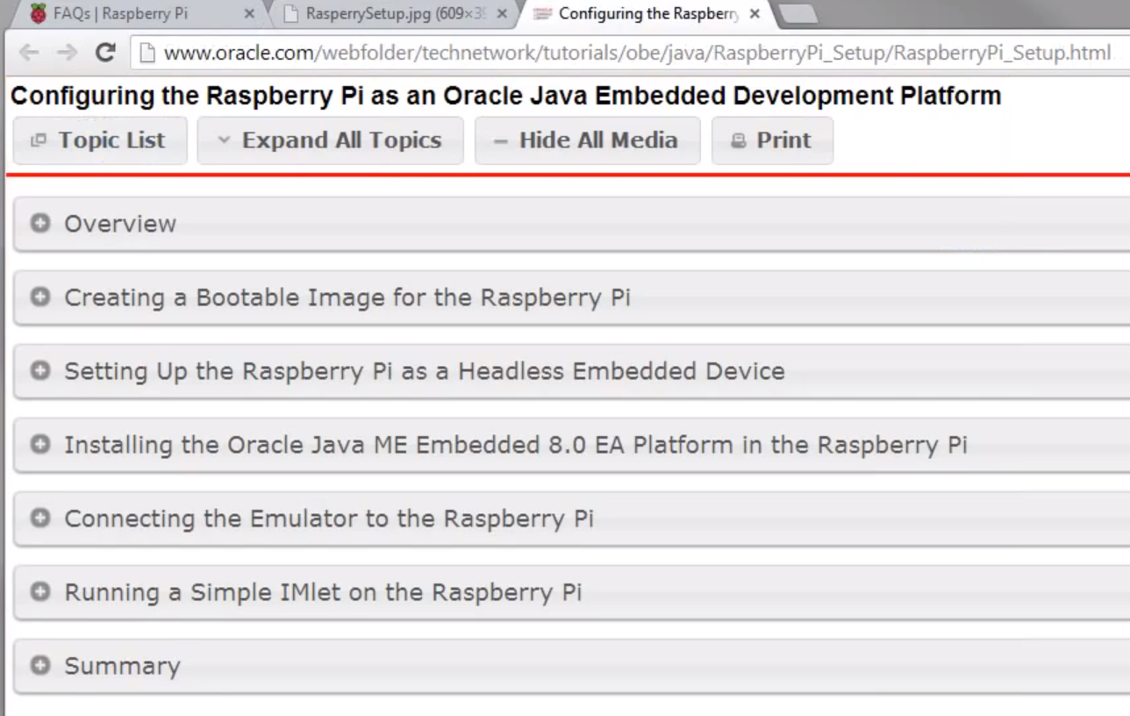
Config the Raspberry Pi for Java Development

Slide 13
Java ME Application Lifecycle Methods
public class SampleApp extends MIDlet {
@Override
public void startApp() {
System.out.println("Starting...");
}
@Override
public void destroyApp(boolean unconditional) {
System.out.println("Destroying...");
}
}

Slide 14
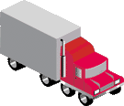

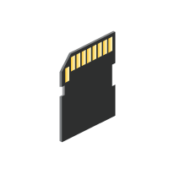
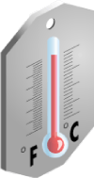

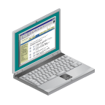

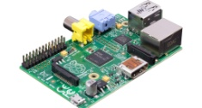
Our Project
... and Some Relevant Concepts Discussed
GPIO
I²C
GPS, UART
RMS
JavaFX
Pressure/ Temperature
Location/ Altitude
Door open/close
Storage
Client Display
In this course, you will build a prototype of an embedded device to collect, store, analyze and share data from a shipping container.
Notes:
The problem: Farmers are placing their fresh crops into a shipping container, and some of those shipments arrive at the distribution center spoiled or damaged. The shipping company has hired you to develop an inexpensive embedded device to collect information from the containers. The goals for the device include: * Completely stand-alone operation and low-power (Raspberry Pi and Java ME Embedded 8) * Record the number of times and when the shipping container door is opened (switches) * Record the temperature in the container at regular intervals (Barometric Pressure/Temperature sensor) * Record the location of the container at regular intervals (Adafruit GPS Breakout)
* Store the data collected locally on the device * Respond to a request to download the information wirelessly (WiFi module)

Slide 15

Lesson 2: Using the GPIO and I2C on the Raspberry Pi

Slide 16
In This Lesson…
GPIO
I²C
Pressure/ Temperature
Location/ Altitude
Door open/close
Storage
Client Display
In this course, you will build a prototype of an embedded device to collect, store, analyze and share data from a shipping container.
Notes:
The problem: Farmers are placing their fresh crops into a shipping container, and some of those shipments arrive at the distribution center spoiled or damaged. The shipping company has hired you to develop an inexpensive embedded device to collect information from the containers. The goals for the device include: * Completely stand-alone operation and low-power (Raspberry Pi and Java ME Embedded 8) * Record the number of times and when the shipping container door is opened (switches) * Record the temperature in the container at regular intervals (Barometric Pressure/Temperature sensor) * Record the location of the container at regular intervals (Adafruit GPS Breakout)
* Store the data collected locally on the device * Respond to a request to download the information wirelessly (WiFi module)

Slide 17
Lesson 2 Agenda
Getting started with the hardware
Working with GPIO on the Raspberry Pi
I²C Overview
Enabling I²C on the Raspberry Pi
Writing code for I²C

Slide 18
Lesson 2.1: Raspberry Pi Cooking Class: Lets see the Ingredients

Slide 19
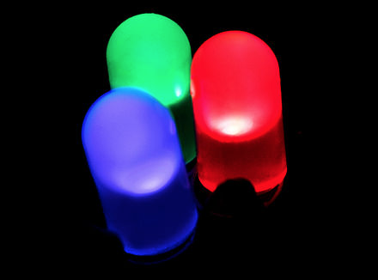
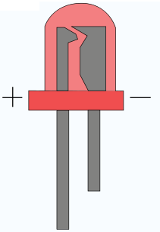
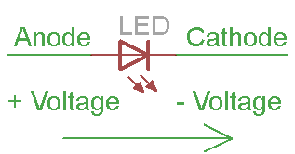
Hardware
LED
Light Emitting Diode (LED): red, green, blue
Two wires:
Anode positive, longest, and
Cathode negative, shortest
Notes:
In any 'loop' of a circuit, the voltages must balance: the amount generated = the amount used This "Voltage Loop" law was discovered by a fellow named Kirchhoff (thus it is called Kirchhoff's Voltage Law = KVL).

Slide 20
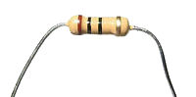
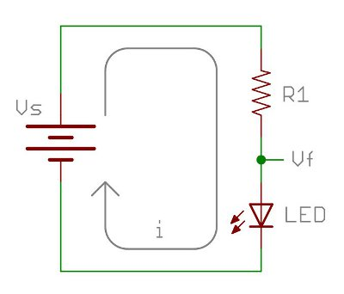
Hardware
Resistors
Their job is to “resist”, regulate or to set the flow of electrons (current) through them.
Used with LED to keep the current at specific level: characteristic forward current
560Ω and 10KΩ
Notes:
there is a specification for diodes called the characteristic (or recommended) forward voltage (usually between 1.5-4V for LEDs). You must reach the characteristic forward voltage to turn 'on' the diode or LED, but as you exceed the characteristic forward voltage, the LED's resistance quickly drops off. Therefore, the LED will begin to draw a bunch of current and in some cases, burn out. A resistor is used in series with the LED to keep the current at a specific level called the characteristic (or recommended) forward current.

Slide 21
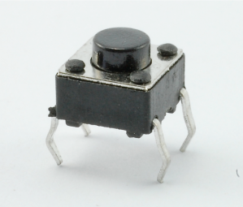
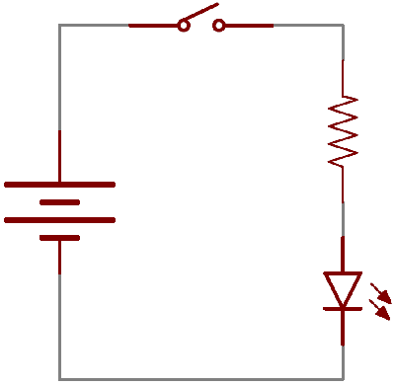
Hardware
Switch
Switch is a component which controls the open-ness or closed-ness of an electric circuit.
Two states:
Off: looks like an open gap in the circuit (open circuit), preventing current from flowing.
On: acts just like a piece of wire (closes the circuit), turning the system “on” and allowing current to flow
Momentary switch:
only on when the button is pressed.
you release the button, the circuit is broken.

Slide 22
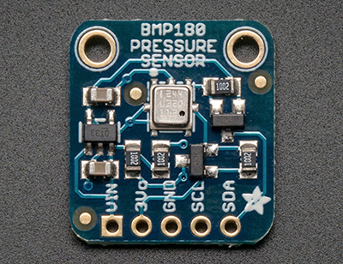
Hardware
BMP180
Measure barometric pressure and temperature
Specifications:
Pressure sensing range: 300-1100 hPa (9000m to -500m above sea level)
Up to 0.03hPa / 0.25m resolution
-40 to +85°C operational range, +-2°C temperature accuracy
2-pin I²C interface on chip
Uses 3.3-5V power and logic level for more flexible usage

Slide 23
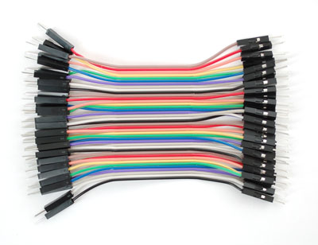
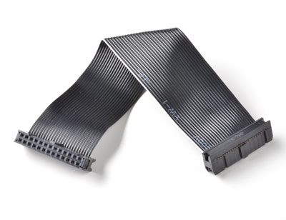
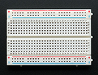
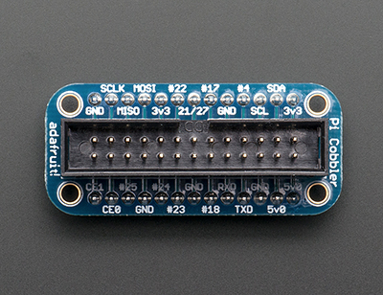
Hardware
Connecting things…
Jumper cables
GPIO ribbon cable
Breadboard
Pi Cobbler Breakout

Slide 24
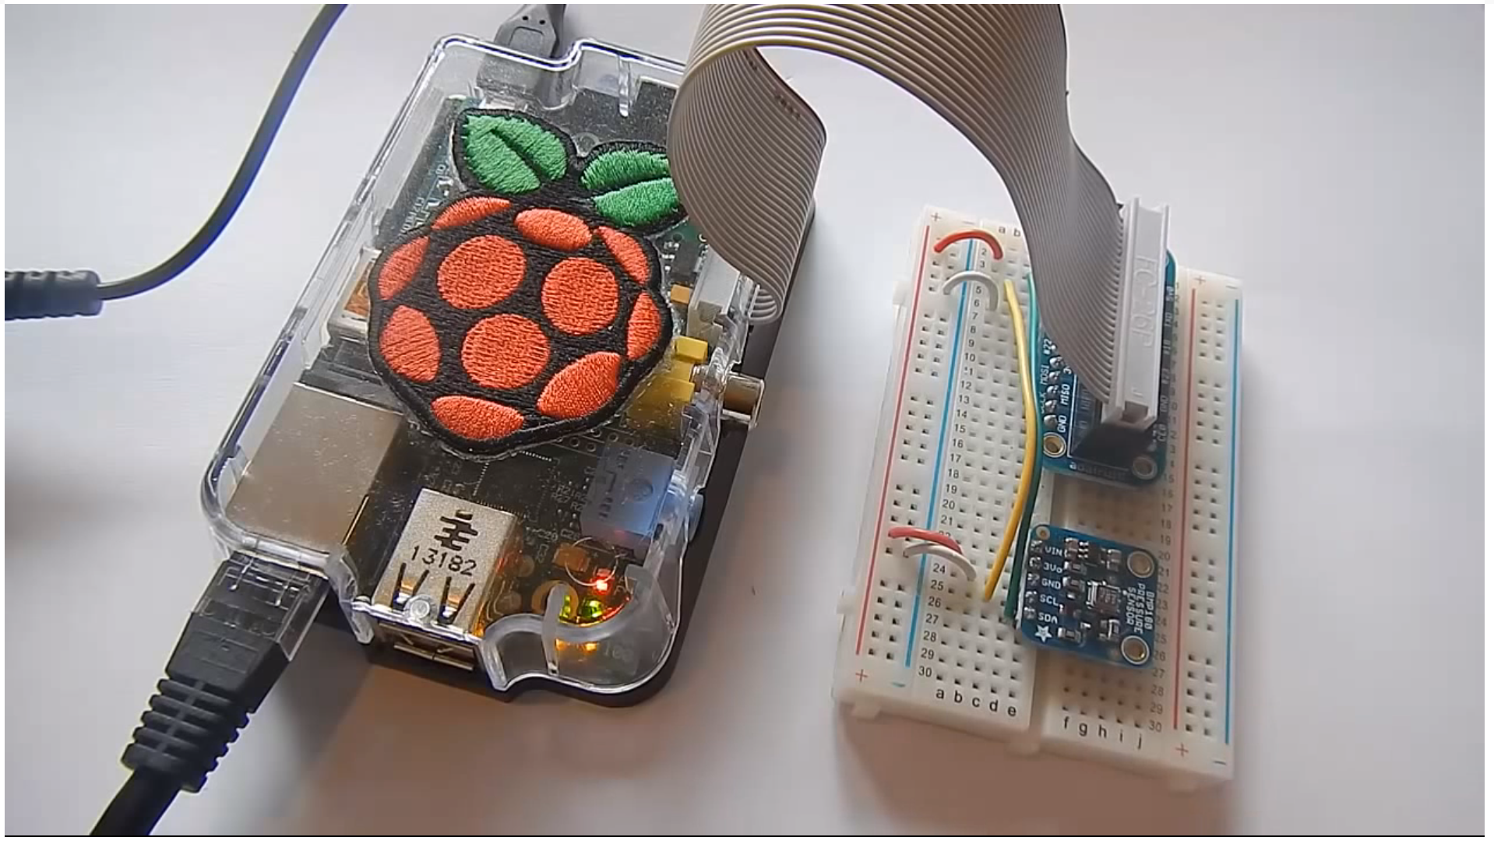
Some hardware connected to the Raspberry Pi

Slide 25
Lesson 2.2: Getting Started with GPIO

Slide 26
General Purpose Input/Output (GPIO)
GPIO pin is a generic pin with high or low
Its behavior can be programmed through software.
GPIO port is a platform-defined grouping of GPIO pins (often 4 or more pins).
GPIOPin pin = DeviceManager.open(1);
GPIOPort port = DeviceManager.open(0);
pin.setValue(true);
port.setValue(0xFF)

Slide 27
GPIOPin Interface
Provides methods for controlling a GPIO pin.
A GPIO pin can be configured for output or input.
Output pins are both writable and readable
Input pins are only readable
GPIOPin.INPUT GPIOPin.OUTPUT
Get its value by polling, or register a PinListener
To register a PinListener: setInputListener(PinListener)
To remove the listener: setInputListener(null)
Writing a GPIOPin results in UnsupportedOperationException

Slide 28
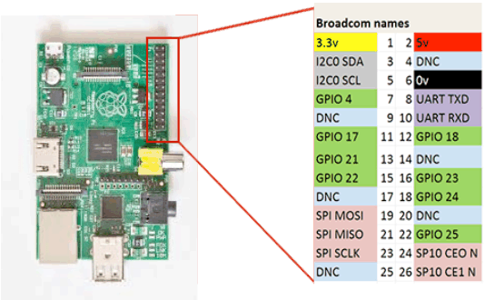
GPIO Pins on the Raspberry Pi

Slide 29
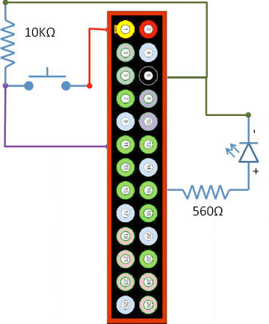
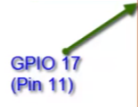
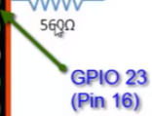
Turning a LED ON and OFF
The Circuit

Slide 30
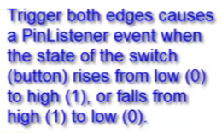
GPIO with Device Access API
public class GPIOTest implements PinListener {
...
private static final int BTN_PIN = 17;
private static final int BTN_PORT = 0;
private static final int LED1_ID = 23;
...
GPIOPinConfig config1 = new GPIOPinConfig(BTN_PORT,
BTN_PIN,
GPIOPinConfig.DIR_INPUT_ONLY,
DeviceConfig.DEFAULT,
GPIOPinConfig.TRIGGER_BOTH_EDGES,
false);
GPIOPin button1 = DeviceManager.open(config1);
GPIOPin led1 = DeviceManager.open(LED1_ID);
button1.setInputListener(this);

Slide 31
GPIO with Device Access API
@Override
public void valueChanged(PinEvent event) {
GPIOPin pin = event.getDevice();
try {
if (pin == button1) {
// Toggle the value of the led
led1.setValue(!led1.getValue());
}
} catch (IOException ex) {
System.out.println("IOException: " + ex);
}
}

Slide 32
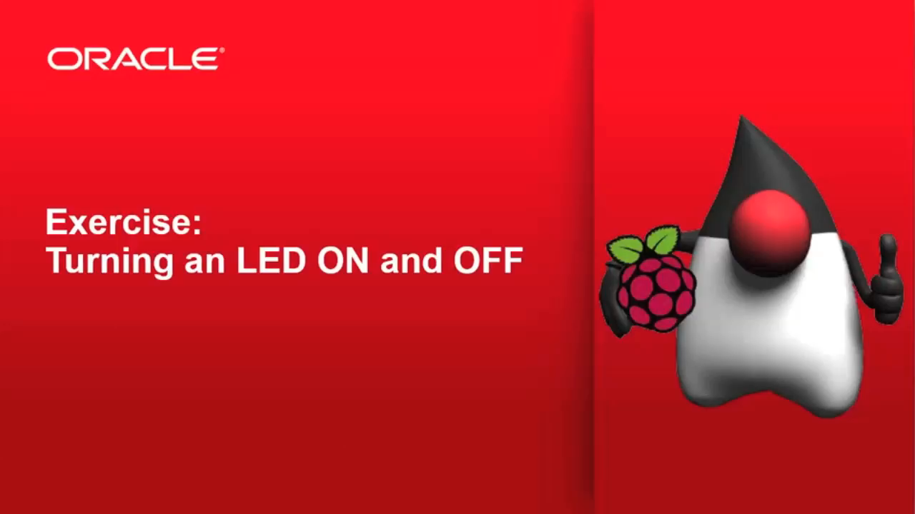
Lets run it…

Slide 33
Homework: Create a Door Sensor
Ingredients:
1 Green LED
1 Red LED
1 Momentary switch

Slide 34
Door open/close
GPIO
Pressure/ Temperature
Location/ Altitude
Door open/close
Storage
Client Display
In this course, you will build a prototype of an embedded device to collect, store, analyze and share data from a shipping container.
Notes:
The problem: Farmers are placing their fresh crops into a shipping container, and some of those shipments arrive at the distribution center spoiled or damaged. The shipping company has hired you to develop an inexpensive embedded device to collect information from the containers. The goals for the device include: * Completely stand-alone operation and low-power (Raspberry Pi and Java ME Embedded 8) * Record the number of times and when the shipping container door is opened (switches) * Record the temperature in the container at regular intervals (Barometric Pressure/Temperature sensor) * Record the location of the container at regular intervals (Adafruit GPS Breakout)
* Store the data collected locally on the device * Respond to a request to download the information wirelessly (WiFi module)

Slide 35
The Door Sensor
What we are trying to do
The idea is to show the door status via LEDs.
If the door is closed, the packages are safe in the truck: green LED is ON
If the door is open, we should warn: red LED is ON, or blinking (your choice)
Pins used in the solution (not required to be the same)
Green LED in pin 23
Red LED in pin 24
Switch in pin 17

Slide 36
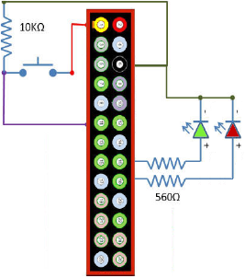
The Wiring
GPIO 23
GPIO 17
GPIO 24

Slide 37
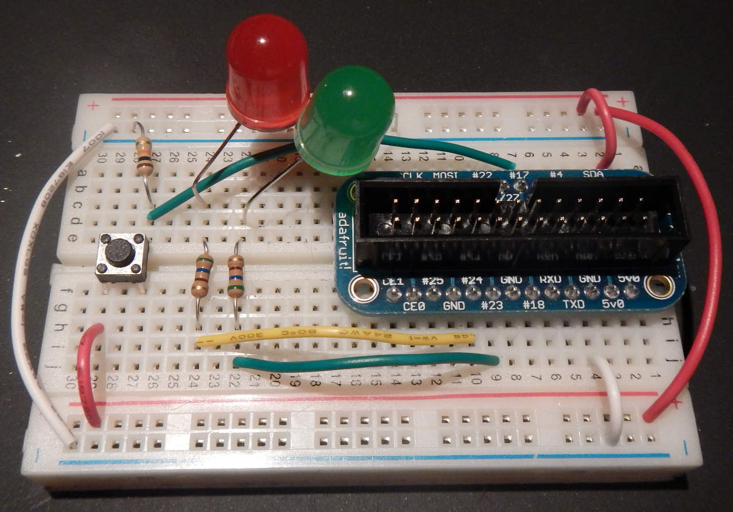
The Wiring
3V
GND
3V
GND

Slide 38
Lesson 2.4: I2C Overview

Slide 39
Pressure / Tempurature
I²C
Pressure/ Temperature
Location/ Altitude
Door open/close
Storage
Client Display
In this course, you will build a prototype of an embedded device to collect, store, analyze and share data from a shipping container.
Notes:
The problem: Farmers are placing their fresh crops into a shipping container, and some of those shipments arrive at the distribution center spoiled or damaged. The shipping company has hired you to develop an inexpensive embedded device to collect information from the containers. The goals for the device include: * Completely stand-alone operation and low-power (Raspberry Pi and Java ME Embedded 8) * Record the number of times and when the shipping container door is opened (switches) * Record the temperature in the container at regular intervals (Barometric Pressure/Temperature sensor) * Record the location of the container at regular intervals (Adafruit GPS Breakout)
* Store the data collected locally on the device * Respond to a request to download the information wirelessly (WiFi module)

Slide 40
Hardware
BMP180
Measure barometric pressure and temperature
Specifications:
Pressure sensing range: 300-1100 hPa (9000m to -500m above sea level)
Up to 0.03hPa / 0.25m resolution
-40 to +85°C operational range, +-2°C temperature accuracy
2-pin I²C interface on chip
Uses 3.3-5V power and logic level for more flexible usage

Slide 41
I²C Overview
Used for moving data simply and quickly from one device to another
Serial Interface
Synchronous:
The data (SDA) is sent along with a clock signal (SCL)
The clock signal controls when data is changed and when it should be read
Clock rate can vary, unlike asynchronous (RS-232 style) communications
Bidirectional
Notes:
with a slave device. Data is exchanged between these devices.
Since I2C is synchronous, it has a clock pulse along with the data. RS232 and other
asynchronous protocols do not use a clock pulse, but the data must be timed very
accurately.
Since I2C has a clock signal, the clock can vary without disrupting the data. The
data rate will simply change along with the changes in the clock rate. This makes
I2C ideal when the micro is being clocked imprecisely, such as by a RC oscillator.

Slide 42
I²C In Few Words…
Inter-Integrated Circuit, ("two-wire interface")
Multi-master serial single-ended computer bus
Invented by Philips for attaching low-speed peripherals to a motherboard, embedded system, cellphone, or other electronic device.
Uses two bidirectional open-drain lines
Serial Data Line (SDA) and
Serial Clock (SCL),
pulled up with resistors.
Typical voltages used are +5 V or +3.3 V
Notes:
IÇC uses only two bidirectional open-drain
lines, Serial Data Line (SDA) and Serial
Clock (SCL), pulled up with resistors.
Typical voltages used are +5 V or +3.3 V
although systems with other voltages are
permitted.
The IÇC reference design has a 7-bit or a
10-bit (depending on the device used)
address space. [5] Common IÇC bus speeds
are the 100 kbit/s standard mode and the 10
kbit/s low-speed mode, but arbitrarily low
clock frequencies are also allowed. Recent revisions of IÇC can host more nodes and run at faster speeds
(400 kbit/s Fast mode, 1 Mbit/s Fast mode plus or Fm+, and 3.4 Mbit/s High Speed mode). These speeds
are more widely used on embedded systems than on PCs. There are also other features, such as 16-bit
addressing.

Slide 43
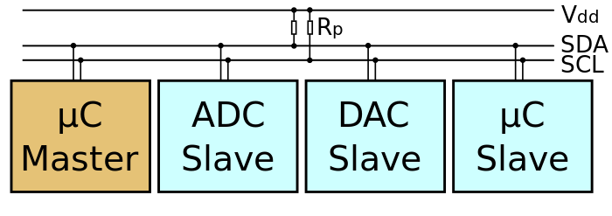
I²C Design
A bus with a clock (SCL) and data (SDA) lines
7-bit addressing.
Roles:
Master: generates the clock and initiates communication with slaves
Slave: receives the clock and responds when addressed by the master
Multi-Master bus
Switch between master and slave allowed
Notes:
The aforementioned reference design is a bus with a clock (SCL) and data (SDA) lines with 7-bit
addressing. The bus has two roles for nodes: master and slave:
Master node — node that generates the clock and initiates communication with slaves
Slave node — node that receives the clock and responds when addressed by the master
The bus is a multi-master bus which means any number of master nodes can be present. Additionally,
master and slave roles may be changed between messages (after a STOP is sent).
There are four potential modes of operation for a given bus device, although most devices only use a
single role and its two modes:
master transmit — master 1. node is sending data to a slave
2. master receive — master node is receiving data from a slave
3. slave transmit — slave node is sending data to the master
4. slave receive — slave node is receiving data from the master

Slide 44
Lesson 2.6: Using I²C on the Raspberry Pi

Slide 45
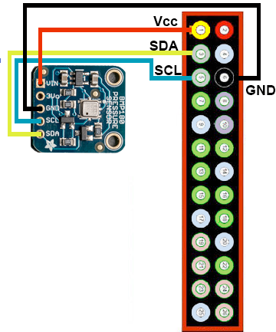
Wiring and operating the BMP180
Raspberry Pi uses I²C bus 1
We’re using device address 0x77
I²C uses 7 bits for device address
BMP180 uses clock frequency 3.4MHz
Control register for BMP180 is 0xF4
Temperature value is at register 0xF6.

Slide 46
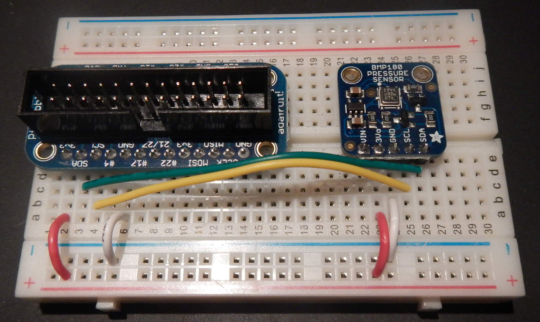
The Wiring

Slide 47
Reading and writing to I2C devices
I2CDeviceConfig config =
new I2CDeviceConfig(1, // I2C bus number
0x77, // I2C device address
7, // address size in bits
3400000); // Clock frequency
myDevice = DeviceManager.open(config);
myDevice.write(0xF4, 1, 0x2E); // control register, size,
// get temperature command
myDevice.read(0xF6, 1, buf); // temperature register,
// subaddress size, ByteBuffer

Slide 48
Lesson 3: Using the UART, GPS, and Storing Data

Slide 49
GPS, UART
RMS
Pressure/ Temperature
Location/ Altitude
Door open/close
Storage
Client Display
In this course, you will build a prototype of an embedded device to collect, store, analyze and share data from a shipping container.
Notes:
The problem: Farmers are placing their fresh crops into a shipping container, and some of those shipments arrive at the distribution center spoiled or damaged. The shipping company has hired you to develop an inexpensive embedded device to collect information from the containers. The goals for the device include: * Completely stand-alone operation and low-power (Raspberry Pi and Java ME Embedded 8) * Record the number of times and when the shipping container door is opened (switches) * Record the temperature in the container at regular intervals (Barometric Pressure/Temperature sensor) * Record the location of the container at regular intervals (Adafruit GPS Breakout)
* Store the data collected locally on the device * Respond to a request to download the information wirelessly (WiFi module)

Slide 50
Lesson Agenda
UART serial protocol overview
GPS overview
Connecting the GPS sensor using a USB UART cable
Connecting the GPS directly to the Raspberry Pi UART
Reading GPS data in a Java ME 8 Embedded application
Saving GPS data in the Record Management Store
Saving GPS data in a file

Slide 51
Lesson 3-1: UART Serial Protocol Overview

Slide 52
UART Serial Protocol
The Basics
UART = Universal Asynchronous Receiver and Transmitter
Serial communication
Each bit is sent one after the other
Both ends must be set to work at the same speed
bits per second
Standard speeds (9600, 19200, 115200, etc)
Some devices use non-standard speeds
At idle, with no data the connection is held high (voltage)

Slide 53
UART Protocol
Character Frame
Data (5-9 bits)
Start
Data 0
Data 1
Data 2
Data 3
Data 4
Data 5
Data 6
Data 7
Parity
Stop 1
Stop 2
LOGIC
LOW (0)
LOGIC
HIGH (1)
LOGIC
HIGH (1)

Slide 54
Serial Data Transmission
UART does not usually drive transmission of data
RS-232, RS-422, RS-485
Transmission does not need to be electrical
Bluetooth serial port profile
Infra red (IRDa)
Acoustic modem (telephone line)

Slide 55
Lesson 3-2: GPS Overview

Slide 56
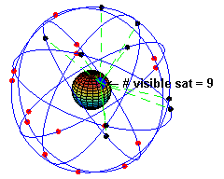
Global Positioning System
Image courtesy of Wikipedia

Slide 57
GPS
Satellite Navigation System
Position is calculated using satellites that continually transmit data
Time and the position above the earth
Minimum of three satellites required to get position
latitude and longitude
Four satellites required to get 3D position fix
latitude/longitude/altitude

Slide 58
GPS Receiver
Data Format
GPS receivers typically use NMEA 0183 standard
National Marine Electronics Association
Text based protocol
Message starts with a $ sign
Next five letters identify the talker (2 letters) and type (3 letters)
GPS receiver talker code is GP
Data fields are comma separated
Message contains optional aterisk * and two digit checksum at the end
Message is terminated with carriage return, line feed (13, 10 ASCII)

Slide 59
Lesson 3-3: Connecting the GPS Sensor To The Raspberry Pi

Slide 60
Connection Methods
1. Using a USB to TTL UART adapter
2. Direct connection to the Raspberry Pi header pins

Slide 61
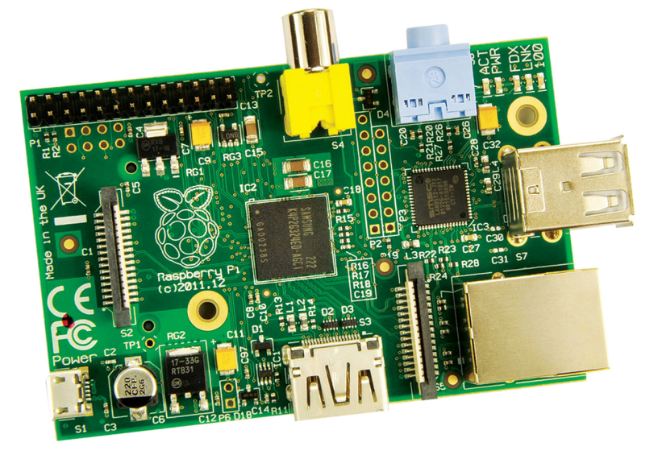
Raspberry Pi USB Connectors
2 x USB 2.0 Type A sockets
Host USB
Differs slightly from USB specification
Power should be 500mA max
Actual is less than 200mA
Can power the board through these
Micro USB socket
- Power only

Slide 62
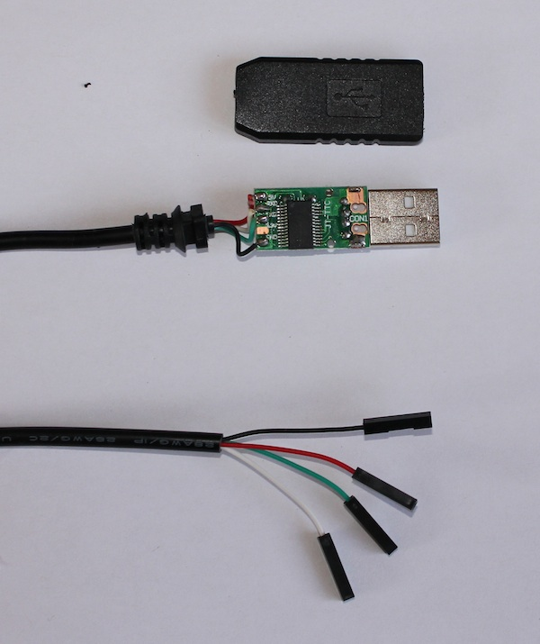
USB UART Cable
PL2003 UART TTL-USB
USB Adapter
(Vcc can be +3.3V or +5V)
GND (Black)
Vcc +5V (Red)
TX (Green)
RX (White)

Slide 63
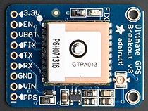
USB UART Adapter Connections
USB Green connects to GPS RX
USB White connects to GPS TX

Slide 64
USB UART Raspberry Pi Configuration
Plug in USB UART adapter to Raspberry Pi
Device to use is /dev/ttyUSB0

Slide 65
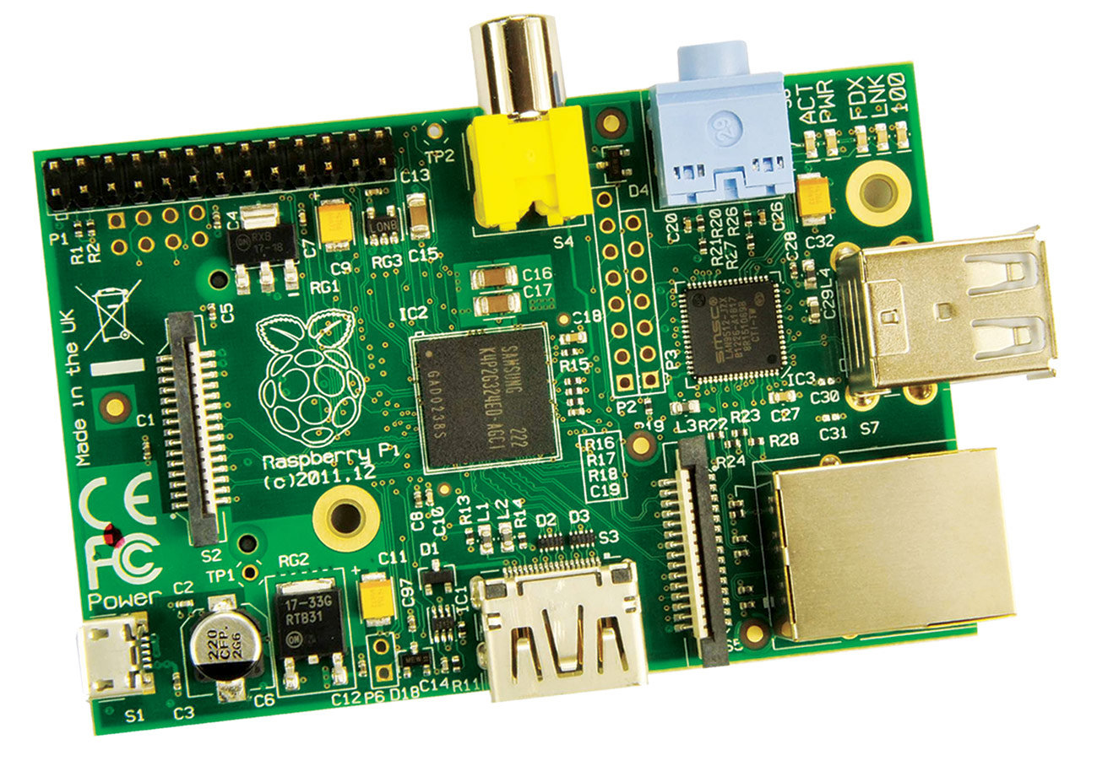
Raspberry Pi Headers
JTAG
P2 = Processor
P3 = LAN
Connections (P1)
GPIO
I2C
SPI
UART
Display (Not supported)
Camera

Slide 66
Header Pin Layout
Power
GPIO
{
UART
UART
I2C
14 (TXD)
SPI
15 (RXD)
5V
5V
GND
18
GND
23
24
GND
25
8
7
P1-01
0 (SDA)
1 (SCL)
4
GND
17
27
22
GND
10 (MOSI)
9 (MISO)
GND
3.3V
11 (SCLK)

Slide 67
UART Connections
NOTE: RX TX
TX RX
TX
RX
P1-01

Slide 68
Lesson 3-4: Reading GPS Data in a Java ME 8 Embedded Application

Slide 69
Using The UART
Getting a BufferedReader
UART uart = DeviceManager.open(40); //UART ID #
uart.setBaudRate(9600);
InputStream is = Channels.newInputStream(uart);
InputStreamreader isr = new InputStreamReader(is);
BufferedReader reader = new BufferedReader(isr);

Slide 70
UART Device Security
Need to add API permission
Application Descriptor
Permission
jdk.dio.DeviceMgmtPermission
Protected resource name
*:*
Actions requested
open

Slide 71
Reading GPS Data
All data lines start with $
Read lines until we get one with the right start character
Check the talker is GP
Test for the correct type (GGA or VTG)
Decode comma separated values
Data appears to be easily corrupted
Short reads, $ in middle of line, not enough fields
Repeat reads until valid data extracted

Slide 72
Lesson 3-5: Saving GPS Data in the Record Management System

Slide 73
GPS, UART
RMS
Pressure/ Temperature
Location/ Altitude
Door open/close
Storage
Client Display
In this course, you will build a prototype of an embedded device to collect, store, analyze and share data from a shipping container.
Notes:
The problem: Farmers are placing their fresh crops into a shipping container, and some of those shipments arrive at the distribution center spoiled or damaged. The shipping company has hired you to develop an inexpensive embedded device to collect information from the containers. The goals for the device include: * Completely stand-alone operation and low-power (Raspberry Pi and Java ME Embedded 8) * Record the number of times and when the shipping container door is opened (switches) * Record the temperature in the container at regular intervals (Barometric Pressure/Temperature sensor) * Record the location of the container at regular intervals (Adafruit GPS Breakout)
* Store the data collected locally on the device * Respond to a request to download the information wirelessly (WiFi module)

Slide 74
Our Midlet suite
Stores and retrieves sensor data
Sensor data in
RMS RecordStore

Slide 75
Record Management System (RMS) Overview
Defined in Java ME Embedded Profile 8.0
Java ME does not rely on being able to store data in files
Some small and embedded devices do not have file systems
Java ME stores application data in non-volatile memory
How this happens is abstracted away by the RMS
RMS can be thought of as a very simple database
Two columns
Record ID
Data (array of bytes)

Slide 76
RecordStore
Storing Data
RecordStore store = RecordStore.openRecordStore("gps-data", true);
String data = position.toString() + "^" + velocity.toString();
byte[] dataBytes = data.getBytes();
int recordNum = store.addRecord(dataBytes, 0, dataBytes.length);

Slide 77
RecordStore
Retrieving Data
Create a new Midlet in the same Midlet suite as the data recorder
Records are retrieved as byte arrays
RecordStore store = RecordStore.openRecordStore("gps-data", false);
recordCount = store.getNumRecords();
for (int i = 1; i < recordCount; i++) // record index is 1 based
System.out.println("Record " + i + " = " +
new String(store.getRecord(i));

Slide 78
Record Store Persistence
The persistence of the Record Store is tied to the MIDlet suite
When the MIDlet suite is removed from the device (destroyed)
The Record Store for that suite is deleted

Slide 79
Lesson 3-6: Saving GPS Data in a File

Slide 80
Java ME And Files Overview
Raspberry Pi has conventional filesystem
So data can be stored there
Java ME supports this through the Generic Connection Framework
Be careful with file URI
Format is file://[root]/[file-path]
Example file, /tmp/gps-data.txt
URI is file://rootfs/tmp/gps-data.txt

Slide 81
Java ME File IO
Generic Connection Framework: FileConnection
private final FileConnection connection;
private final PrintStream fileWriter;
connection =
(FileConnection)Connector.open(
"file://rootfs/tmp/gps-data.txt",
Connector.READ_WRITE);
if (!connection.exists())
connection.create();

Slide 82
Java ME File IO
Use Generic Connection Framework
fileWriter = new PrintStream(
connection.openOutputStream());
fileWriter.println(position + "^" + velocity);

Slide 83
Lesson 4: Communicating the Data to the Outside World

Slide 84
In the grand scheme of this course …
You are here
JavaFX
Pressure/ Temperature
Location/ Altitude
Door open/close
Storage
Client Display
In this course, you are building a prototype of an embedded device to collect, store, analyze and share data from a shipping container.
Notes:
The problem: Farmers are placing their fresh crops into a shipping container, and some of those shipments arrive at the distribution center spoiled or damaged. The shipping company has hired you to develop an inexpensive embedded device to collect information from the containers. The goals for the device include: * Completely stand-alone operation and low-power (Raspberry Pi and Java ME Embedded 8) * Record the number of times and when the shipping container door is opened (switches) * Record the temperature in the container at regular intervals (Barometric Pressure/Temperature sensor) * Record the location of the container at regular intervals (Adafruit GPS Breakout)
* Store the data collected locally on the device * Respond to a request to download the information wirelessly (WiFi module)

Slide 85
Lesson 4-1: Demo a MIDlet that serves sensor data, and a client app that communicates with it

Slide 86
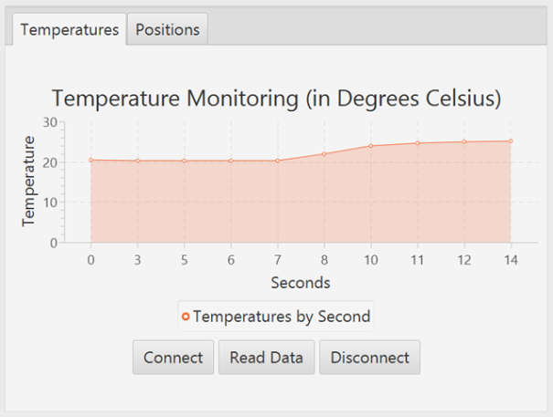
Two more pieces of the prototype puzzle …
An app named VisualClient that communicates with ServerMidlet
Sensor data in
RMS RecordStore
“CONNECT”, “READ”,
“DISCONNECT”
CSV data stream
Port 8042

Slide 87

Taking ServerMidlet and VisualClient for a spin
VisualClient is created with Java/JavaFX and the SceneBuilder tool

Slide 88
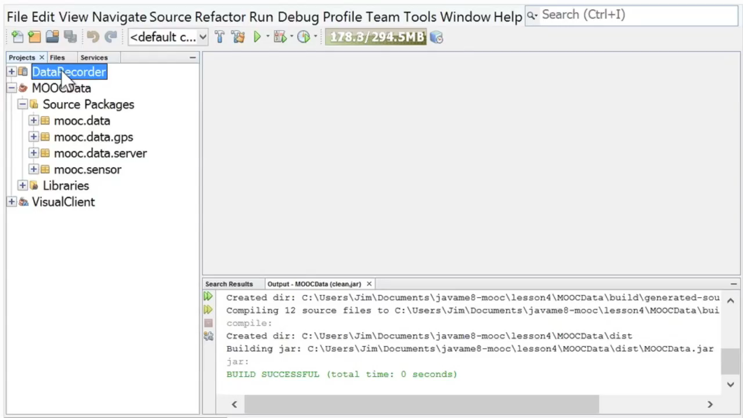
VisualClient and ServerMidlet

Slide 89
Raspberry Pi with Java
Intro to Raspberry Pi and Java ME 8
Raspberry Pi Tricks
#RPiJava8
#DevNexus
James Weaver @JavaFXpert
Stephen Chin @SteveOnJava
Java/IoT/Cloud Technology Ambassadors
Oracle Corporation
Copyright © 2014, Oracle and/or its affiliates. All rights reserved. |

Slide 90
Notes:
This is a Safe Harbor Front slide, one of two Safe Harbor Statement slides included in this template.
One of the Safe Harbor slides must be used if your presentation covers material affected by Oracle’s Revenue Recognition Policy
To learn more about this policy, e-mail: Revrec-americasiebc_us@oracle.com
For internal communication, Safe Harbor Statements are not required. However, there is an applicable disclaimer (Exhibit E) that should be used, found in the Oracle Revenue Recognition Policy for Future Product Communications. Copy and paste this link into a web browser, to find out more information.
http://my.oracle.com/site/fin/gfo/GlobalProcesses/cnt452504.pdf
For all external communications such as press release, roadmaps, PowerPoint presentations, Safe Harbor Statements are required. You can refer to the link mentioned above to find out additional information/disclaimers required depending on your audience.

